Slide 1
World War II
Weapons and Technology

Slide 2
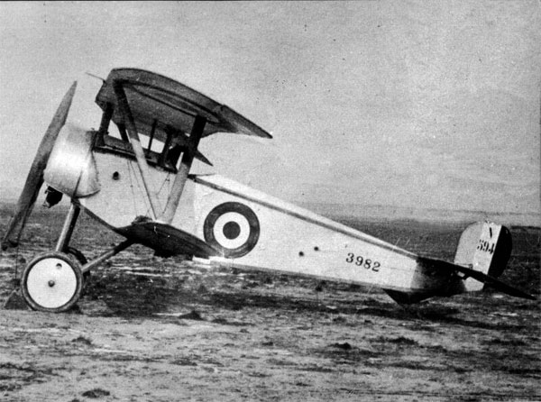
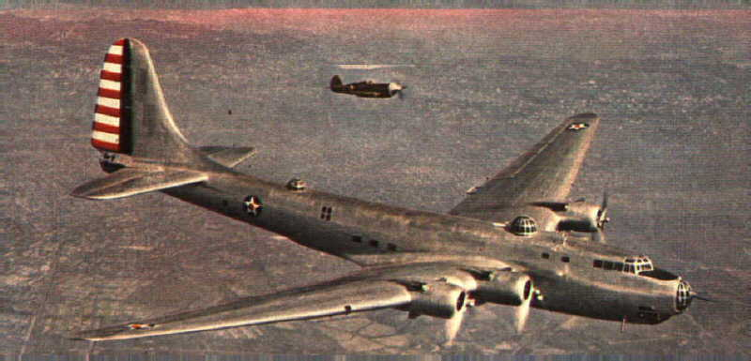
Old Technologies improved
Battle for Britain cartoon

Slide 3
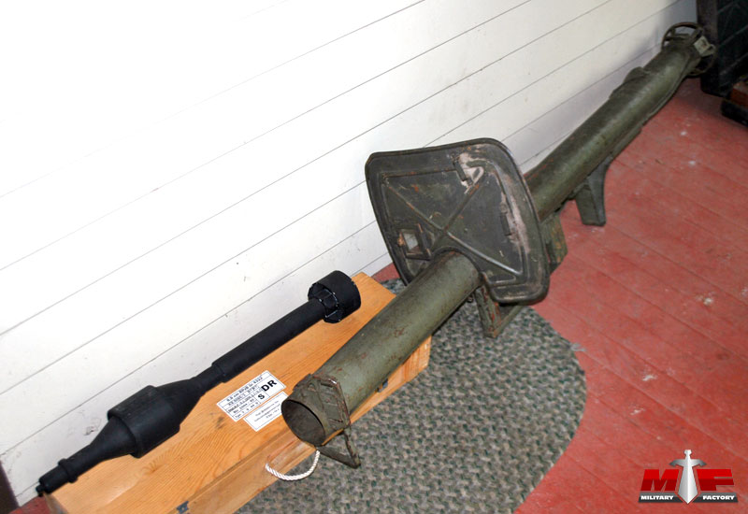
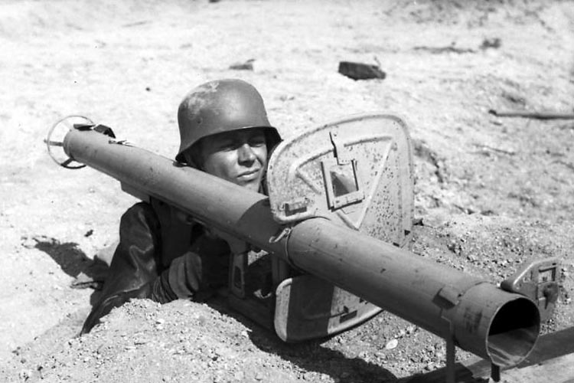
Anti Tank Rocket Launcher
anti tank video

Slide 4
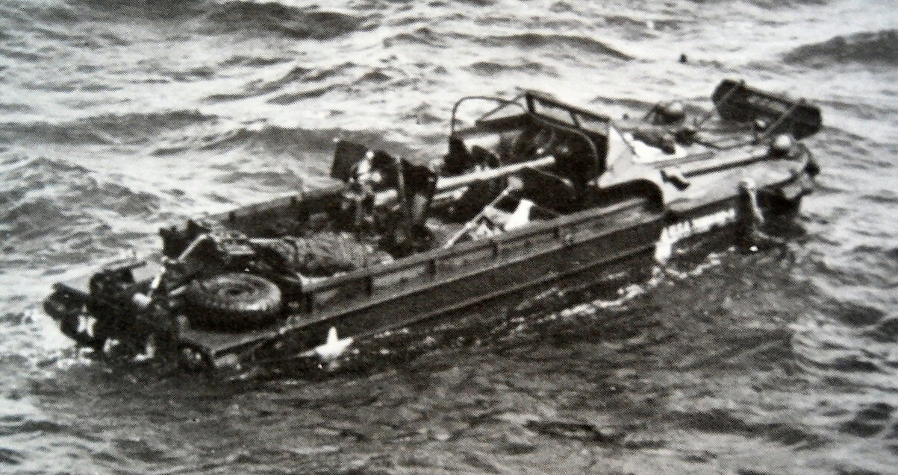
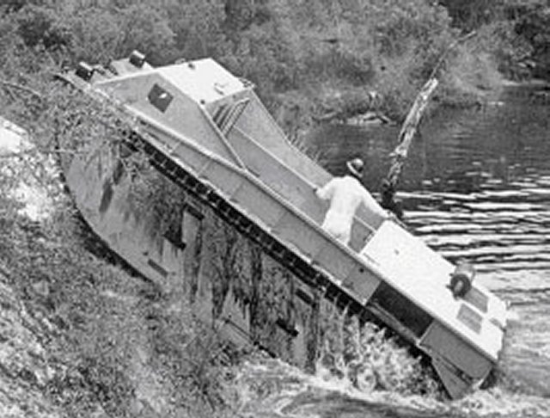
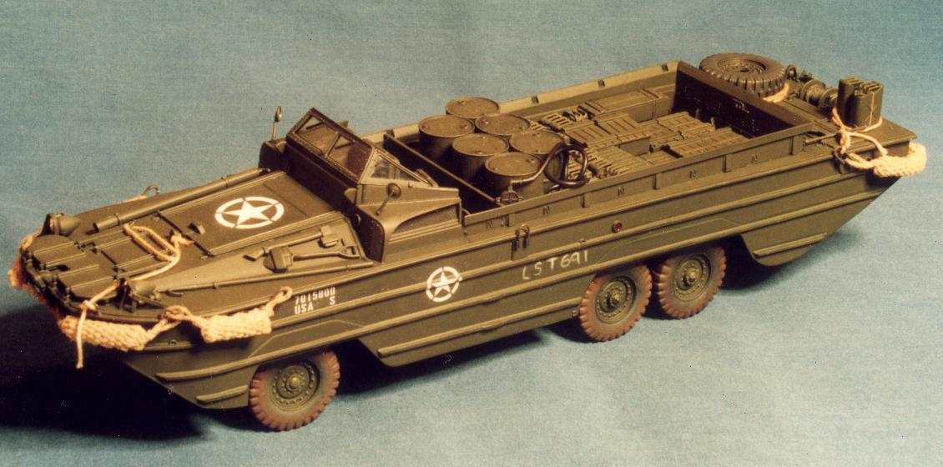
Tracked Landing Vehicle and DUKWs
DUKW

Slide 5
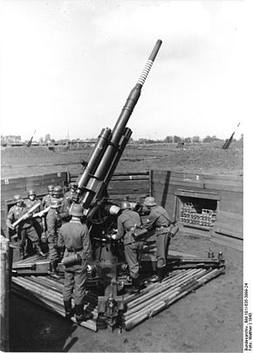
Anti Aircraft Gun
Anti air

Slide 6
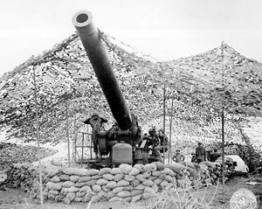
8 inch M1 Howitzer
howitzer

Slide 7
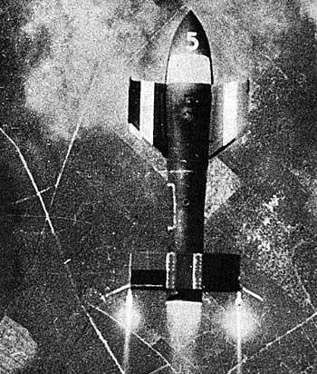
Ruhrstahl SD 1400 “Fritz X”
Fritz X

Slide 8
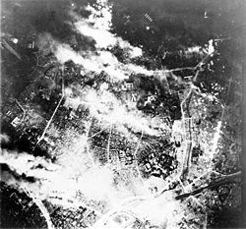
Firebombing
Firebombing of Tokyo

Slide 9
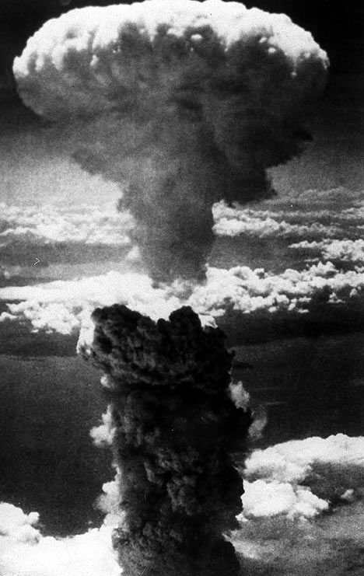
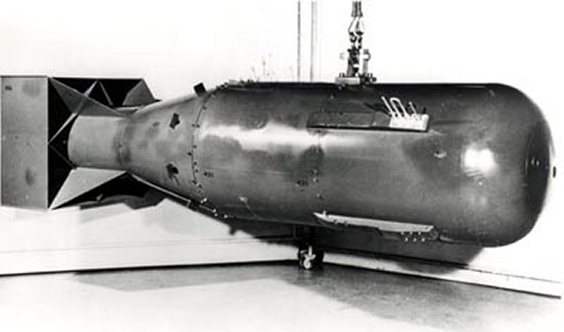
Atomic Bomb
Nagasaki
Atomic Bomb
Atomic Bomb (long)
Nuclear Timeline

Slide 10
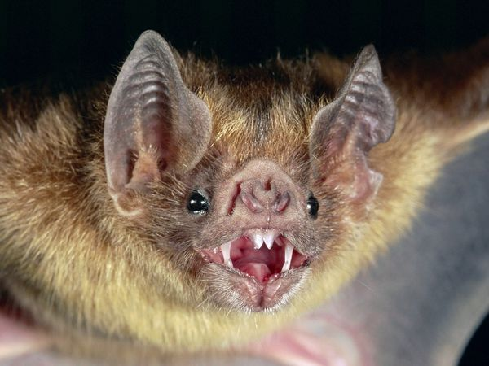
Weird Weapons
Weird Weapons of WWII

Slide 11
Overall Weapon use
Weapons in action

