Slide 1
Europe in Transition
The review

Slide 2
Vocabulary to know!!!

Slide 3
What was the renaissance?
Rebirth of Europe after the Middle Ages
A time when Europeans rediscovered their Roman and Greek heritage in Art, architecture, and education

Slide 4
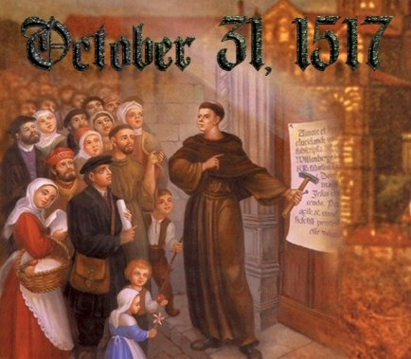
What was the reformation?
Started when Martin Luther opposed the Catholic Church’s selling of indulgences and spurred a movement against the Catholic Church

Slide 5
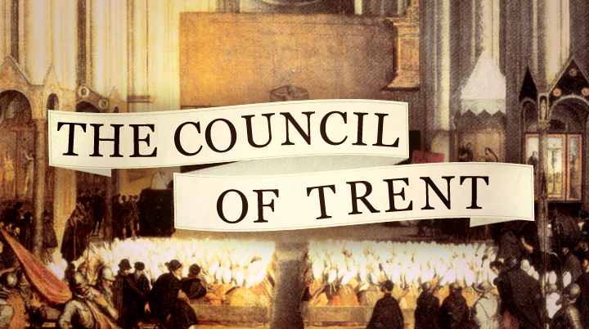
What was the Counter Reformation?
Reaction of the church

Slide 6
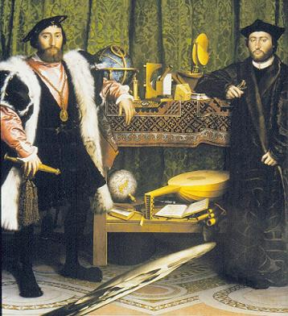
What is humanism?
Idea the people should study the humanities (history, literature, art, etc) in order to become a more rounded person

Slide 7
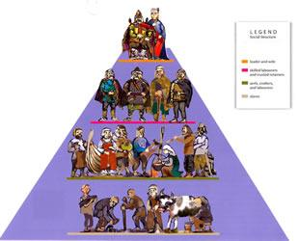
What is a centralized government?
Where there is one strong ruler and little local power given to nobles

Slide 8
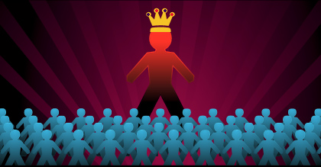
What is an absolute Monarchy?
Government in which the one strong ruler has All of the power and dictates what everyone else does

Slide 9
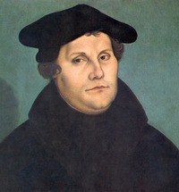
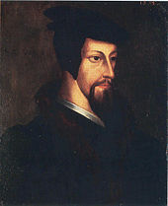
Define protestant
Generally believes one can get to heaven through faith alone

Slide 10
What do the Catholics generally believe?
That one needs the Church to be saved

Slide 11
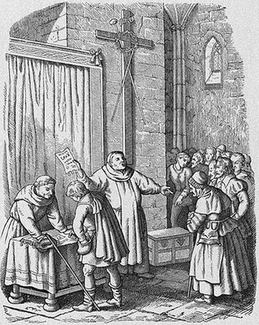
What is an indulgence?
An item sold to an individual to get them out of going to HELL.
(like a get out of jail card!)
Cash My Sin

Slide 12
What was the impact of the Crusades and renaissance?
Revival of Trade
Decline in feudalism
Revival of interest in learning
Cultural interaction with the Middle East

Slide 13
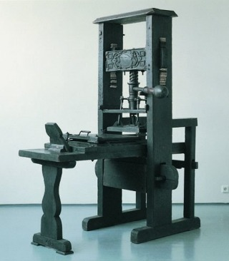
What was an impact of this machine?
Spread of Ideas

Slide 14
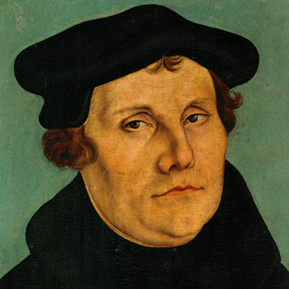
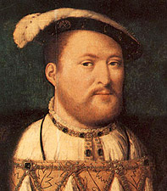
What was a similarity between Martin Luther and Henry Viii?
Wanted to fix the Catholic Church
Challenged the teachings of the Catholic Church
Wanted a divorce

Slide 15
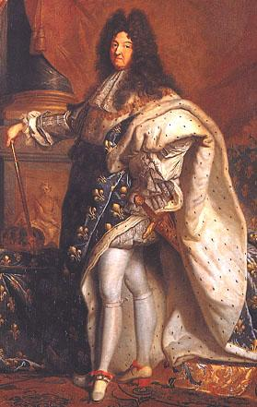
What is absolutism?
Rulers typically claim that they have a divine right
Rulers have total power

Slide 16
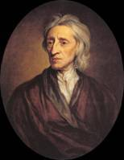
What Major theme came out of the Enlightenment?
ALL individuals have natural rights

